Slide 1
Autoscaling
Lecturer: Ngo Huy Bien
Software Engineering Department
Faculty of Information Technology
VNUHCM - University of Science
Ho Chi Minh City, Vietnam
nhbien@fit.hcmus.edu.vn

Slide 2

Objectives

Slide 3

Contents

Slide 4

References
Trieu C. Chieu et al. (2009). Dynamic Scaling of Web Applications in a Virtualized Cloud Computing Environment.
Claudio A. Ardagna et al. (2012). Scalability Patterns for Platform-as-a-Service.
K. R. Jayaram (2014). Elastic Remote Methods.

Slide 5
Scaling Indicators [1]
In order to scale the application in dynamic manner, it is common to use scaling indicators at the scaling point to monitor and track the performance.
For web applications, typical scaling indicators at the web server may include:
Number of concurrent users.
Number of active connections.
Number of requests per second.
Average response times per request.

Slide 6
Scaling Rules
Once a scaling indicator is selected for use to scale the application, samplings of the scaling indicator are collected in real-time, and statistics is calculated periodically.
Based on the historical trends and predictions derived from the statistics of the scaling indicator, scaling rules can be defined to scale up or down the amount of web application instances.

Slide 7
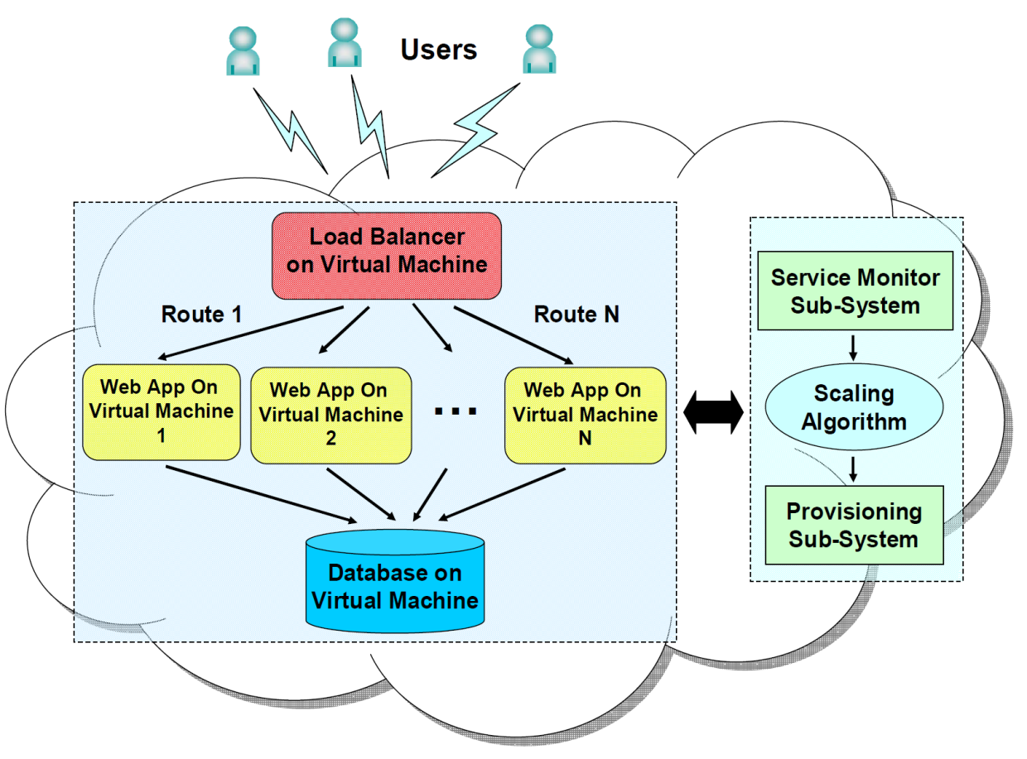
Architecture to Scale Web Applications in a Cloud

Slide 8
Architecture Components
Load-Balancer: Apache HTTP Load-Balancer
The web application and its corresponding web server (Apache HTTP server) is pre-installed in a virtual machine appliance image template.
Service Monitor: A monitoring agent is installed in each web application to track the number of active sessions and to forward the number periodically to the Service Monitor subsystem.
Provisioning sub-system: IBM Tivoli Provisioning Manager (TPM) software product. A number of TPM automation workflows have been developed for different operating systems and virtualization technologies
Scaling Algorithm: If all instances have active sessions above the given upper threshold, a new web application instance will be provisioned, started, and then added to the front-end load-balancer.

Slide 9
Dynamic Scaling Algorithm (I)
The scaling algorithm is implemented in the Service Monitor sub-system, and is used to control and trigger the scale-up or down in the Provisioning sub-system on the number of virtual machine instances based on the statistics of the scaling indicator.
For the sake of illustration, we choose a scaling indicator in our implementation that corresponds to the number of active sessions in the web application of each instance.

Slide 10
Dynamic Scaling Algorithm (II)
The algorithm first determines the current web application instances with active sessions above or below given threshold numbers.
If all instances have active sessions above the given upper threshold, a new web application instance will be provisioned, started, and then added to the front-end load-balancer.
If there are instances with active sessions below a given lower threshold and with at least one instance that has no active session, the idle instance will be removed from the load-balancer and be shutdown from the system.

Slide 11


Slide 12
PaaS Scalability Requirements [2]
PaaS, where operating systems and middleware are virtualized and provided as a service to customers, promises an unprecedented ability of
increasing the capabilities of allocated virtual resources, e.g. CPU, RAM, bandwidth… (scale up – vertical scaling)
seamlessly adding new resources, e.g. new machines (scale out – horizontal scaling), and
releasing them when they are no longer needed (scale down).

Slide 13
Single Platform Pattern
It considers a single-tenant scenario.
A single, isolated, and complete virtual machine with a platform installed on it is released to each customer in the cloud.
This pattern is characterized by scarce resource utilization, since the resource distribution is done in advance independently by the real load, and low scalability, because the number of virtual machines and platforms is linear in the number of customers.

Slide 14
Shared Platform Pattern
It considers a multitenant scenario where a single platform is installed on a (set of) virtual machine.
The platform is shared by multiple tenants, all having the right to manage a portion of it and deploy their services independently.
Whenever the load increases degrading the performance metrics of the platform, RAM, CPU, and/or bandwidth can be increased.
Resources are shared and need to be managed in a way that preserves security and isolation among tenants.
ShPP provides high utilization, while it does not provide linear scalability increase due to the additional overhead for resource management.

Slide 15
Clustered Platform Pattern
A single platform is deployed supporting clustering and is shared by all tenants.
Multiple instances of the platform components (e.g., AS, ESB) can be deployed in different machines of the cluster.
This pattern manages shared resources preserving security and isolation among tenants. In addition, it implements a set of functionalities including load balancing, PaaS monitoring, and elastic auto-scaling.
CPP provides high resource utilization, since the machines in the cluster are shared among different tenants, system resources can be incrementally extended. CPP promises high availability and reliability due to the introduced redundancy.

Slide 16
Multiple Shared Platforms Pattern
It is an extension of ShPP and mix both vertical and horizontal scaling.
At initialization time, a single, shared, multi-tenant platform is deployed.
Upon an increase in the load, additional resources (CPU, RAM, bandwidth) are assigned to maintain the performance metrics.
In case additional resources are not sufficient, a new platform is deployed and a part of the existing tenants are migrated to the new platform together with the services they own.

Slide 17
Multiple Clustered Platforms Pattern
It is an extension of CPP and provides horizontal scaling at two levels of abstraction.
At initialization time, a single, shared, multi-tenant platform supporting clustering is deployed.
Upon an increase in the load, additional resources (i.e., machines in the cluster) are added to maintain the performance level.
In case the extended cluster is not sufficient to manage the new load, a new platform supporting clustering is deployed, and a part of the existing tenants are migrated to the new clustered platform together with the services they own.

Slide 18
PaaS Scalability Pattern Evaluation
Pattern | Manageability | Resource Utilization | Scalability | Availability Reliability
SPP | High | Low | Low | Medium
ShPP | Medium/High | High | Medium | Low
CPP | Medium | High | Medium | High
MShPP | Low | High | High | Medium
MCPP | Low | High | High | High

Slide 19
Session State
Usually a cloud-based application maintain user session on its server side to authorize her at every request.
Session is also used map the user requests to user data in some designs.
A common approach is to store session data in memory.
Unfortunately, this approach doesn't scale very well because the moment the application scales out beyond a single server, it becomes a necessity that the session state must be shared between multiple servers.
The common solution is to store session state on altogether different data store and share it with all the servers.

Slide 20
Statelessness
Statelessness is an important property that every cloud-based application needs to posses in order to achieve scalability and availability.

Slide 21
Tools
http://terracotta.org/products/web-sessions
http://aws.amazon.com/elasticache/
Synchronization with RDS (MySQL, Oracle, MS SQL)
http://aws.amazon.com/dynamodb/
http://www.couchbase.com

Slide 23
Elasticity [3]
Elasticity, the key driver of cloud computing, is the ability of a distributed application to dynamically increase or decrease its use of computing resources, to preserve its performance in response to varying workloads.
Implicit elasticity is typically associated with a specific programming framework or a Platform-as-a-Service (PaaS) cloud.
Implicit elasticity is handled by the PaaS implementation and is not the responsibility of the programmer.

Slide 24
Explicit Elasticity
Explicit Elasticity is typically associated with Infrastructure as-a-Service (IaaS) clouds and/or private data centers, which typically provide elasticity at the granularity of virtualized compute nodes (e.g., Amazon EC2) or virtualized storage (e.g., Amazon Elastic Block Store (EBS)) in a way that is agnostic of the application using these resources.
It is the application developer‘s or the system administrator's responsibility to implement robust mechanisms to monitor the application's performance at runtime, request the addition or removal of resources, and perform load-balancing, i.e., redistribute the application‘s workload among the new set of resources.

Slide 25
Programmable Elasticity
To optimize the performance of new or existing distributed applications while deploying or moving them to the cloud, engineering robust elasticity management components is essential.
This is especially vital for applications that do not fit the programming model of (implicit) elastic frameworks like Hadoop, Pig, etc., but require high performance (high throughput and low latency), scalability and elasticity.
Elasticity frameworks which rely on externally observable resource utilization metrics (CPU, RAM, etc.) are insufficient for such applications.

Slide 26
Elasticity Management Component
Hence, there is an emerging need for a elasticity framework that bridges the gap between implicit and explicit elasticity, allowing the use fine grained application specific metrics (e.g., size of a queue/heap, number of aborted transactions or average number of attempts to acquire certain locks) to build an elasticity management component right into the application.

Slide 27
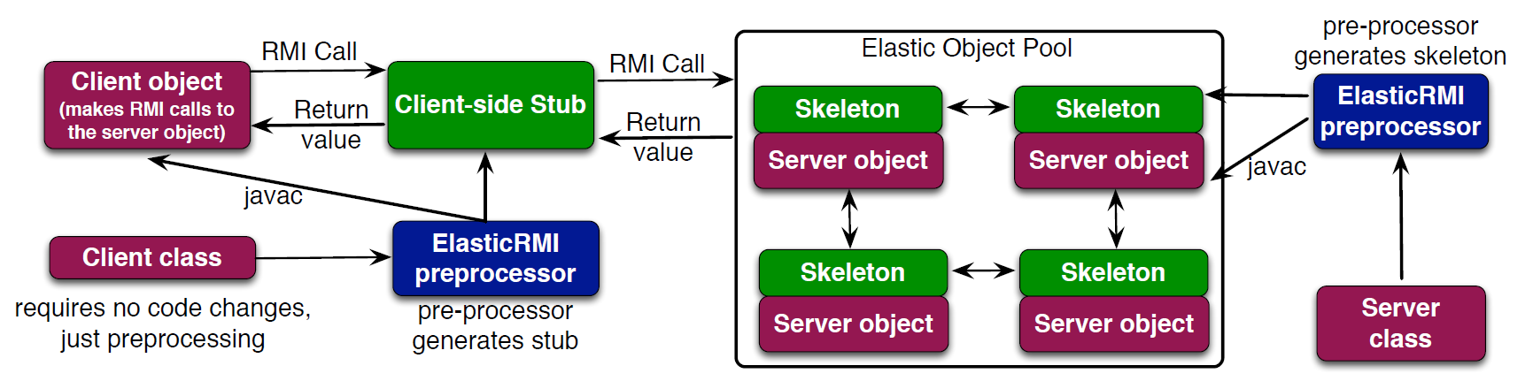
ElasticRMI Application
Like any Java application, an ElasticRMI application consists of multiple components (implemented as classes) interacting with each other.
The basic elasticity abstraction in ElasticRMI is an elastic class.
An elastic class is also a remote class, and (some) of its methods may be invoked remotely from another JVM.
The key dierence between an elastic and a regular remote class is that an elastic class is instantiated into a pool of objects (referred to as elastic object pool), with each object executing on a separate JVM.

Slide 28
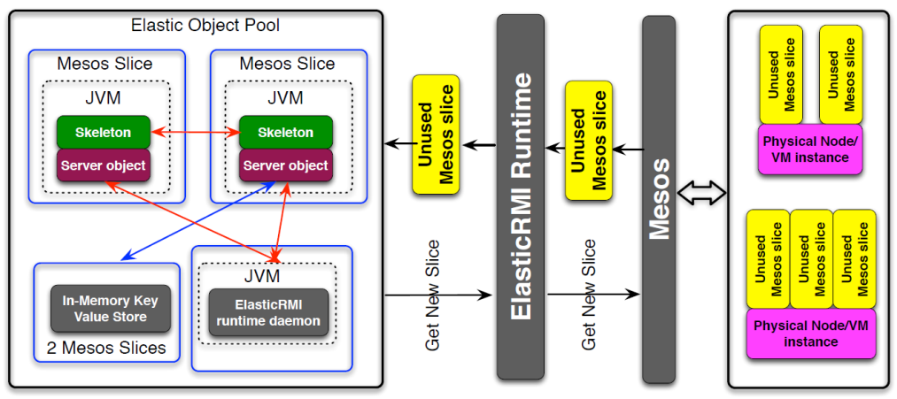
Object Pools
An elastic class can only be instantiated by providing a minimum and maximum number of objects that constitute its elastic object pool.
Obviously, instantiating all objects in the pool on separate JVMs on the same physical machine may degrade performance.
Hence, ElasticRMI attempts to instantiate each object in a virtual node in a compute cluster.

Slide 29
Virtual Nodes
Virtual nodes can be obtained either (1) from IaaS clouds by provisioning and instantiating virtual machines, or (2) from a cluster management/resource sharing system like Apache Mesos.
http://mesos.apache.org/
Apache Mesos abstracts CPU, memory, storage, and other compute resources away from machines (physical or virtual), enabling fault-tolerant and elastic distributed systems to easily be built and run effectively.

Slide 30
Portability
Mesos can also be viewed as a thin resource-sharing layer that manages a cluster of physical nodes/virtual machines.
As long as Mesos is available, ElasticRMI applications can be executed, making them portable across different cloud vendors.

Slide 32
Horizontal Pod Autoscaling
https://kubernetes.io/docs/concepts/workloads/autoscaling/horizontal-pod-autoscale/
Horizontal scaling means that the response to increased load is to deploy more Pods.
If the load decreases, and the number of Pods is above the configured minimum, the HorizontalPodAutoscaler instructs the workload resource (the Deployment, StatefulSet, or other similar resource) to scale back down.
Kubernetes implements horizontal pod autoscaling as a control loop that runs intermittently (it is not a continuous process).

Slide 33
Kubernetes HPA (KHPA) Algorithm
The HorizontalPodAutoscaler controller operates on the ratio between desired metric value and current metric value:
desiredReplicas = ceil [ currentReplicas × (desiredMetricValue/currentMetricValue​) ]
For example, if the current metric value is 200m, and the desired value is 100m, the number of replicas will be doubled, since 200.0 ÷ 100.0 = 2.0.
If the current value is instead 50m, you'll halve the number of replicas, since 50.0 ÷ 100.0 = 0.5.
The control plane skips any scaling action if the ratio is sufficiently close to 1.0.

Slide 35
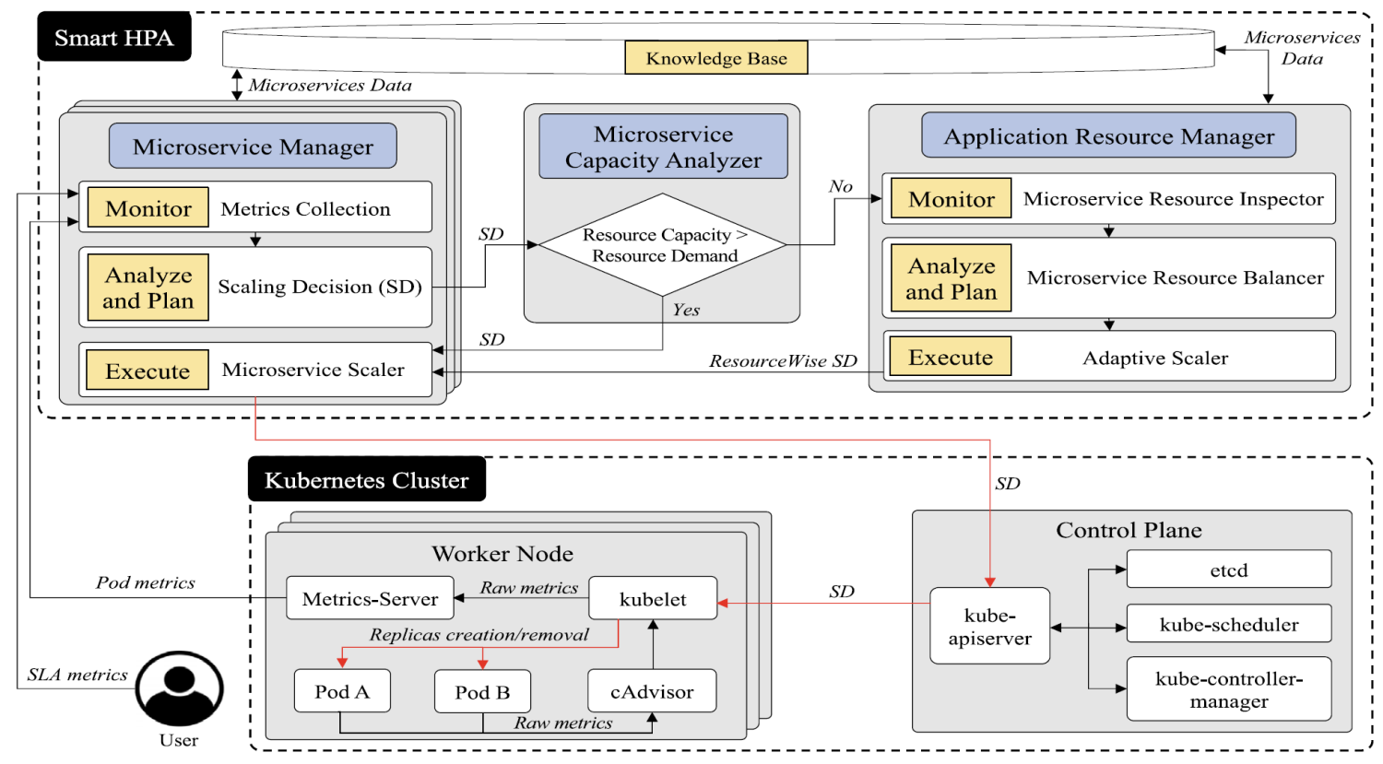
Smart HPA
Hussain Ahmad et al. (2025). Towards resource-efficient reactive and proactive auto-scaling for microservice architectures.
Smart HPA employs a reactive scaling policy that facilitates resource exchange among microservices, optimizing auto-scaling in resource-constrained environments.

Slide 37
Sparse Causal Graphs
(1990). An Algorithm for Fast Recovery of Sparse Causal Graphs.

Slide 38
Topological Potential Theory
(1990). An Algorithm for Fast Recovery of Sparse Causal Graphs.

Slide 39
Scaling Personalized Web Search
(2003). Scaling Personalized Web Search.

Slide 40
PBScaler
Shuaiyu Xie et al. (2023). PBScaler: A Bottleneck-aware Autoscaling Framework for Microservice-based Applications.
We propose TopoRank, a random walk algorithm based on topological potential theory (TPT) to identify performance bottlenecks (PBs).
By taking into account microservice dependencies and anomaly potential, TopoRank improves the accuracy and explainability of bottleneck localization.
After identifying the PBs by TopoRank, PBScaler further employs a genetic algorithm to find nearly optimal strategies.
To avoid application oscillation caused by excessive optimization, the process is conducted offline and is guided by an SLO violation predictor, which simulates the online application and provides feedback to the scaling strategies.

Slide 41
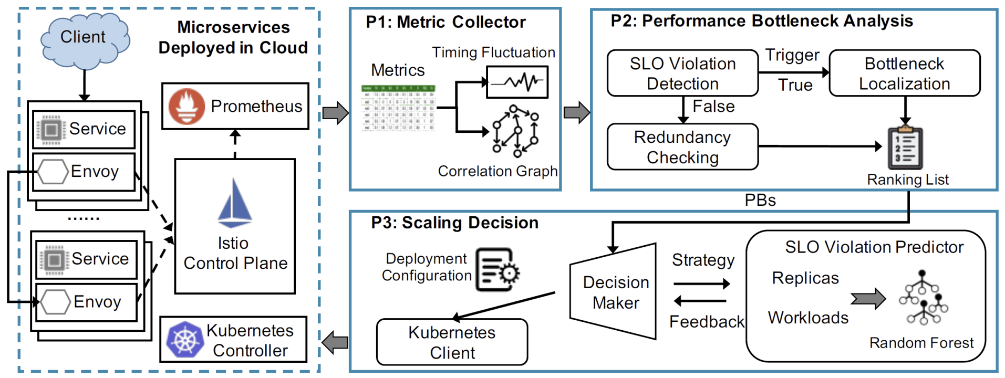
Framework of PBScaler

Slide 42
SLO Violation Detection
PBScaler inspects the P90 tail latency of all invocation edges every 15 seconds to timely detect performance degradation.
If the tail latency of an invocation exceeds a predetermined threshold (such as the SLO), the invoked microservice of the invocation will be added to the set of abnormal microservices, and the bottleneck localization process will be activated.
To account for occasional noise in the microservice latency, the threshold is set to SLO × (1 + α/2), where α is used to adjust the tolerance to noise.

Slide 43
Redundancy Checking
PBScaler uses the rate of workload change per second of microservices to determine whether resources are redundant.
This strategy is more effective than relying only on resource consumption because different microservices may have varying sensitivity to heterogeneous resources.
The main idea behind redundancy checking is to employ hypothesis testing to detect whether a microservice’s current workload is significantly lower than its past workload.
The degree of significance is adjusted by the parameter β.

Slide 44
Bottleneck Localization
Only the bottleneck microservice must be scaled up while the other abnormal microservices are merely implicated.
To pinpoint the bottleneck microservice, we introduce the concept of anomaly potential, which aggregates the anomaly impact of all microservices in a given position.
Based on the anomaly potential, we model the backtracking of anomalies in microservice applications as a random walk on a directed graph.
Therefore, we design a novel bottleneck localization algorithm, TopoRank, which introduces the topological potential theory (TPT) in random walks to calculate the scores for all abnormal microservices and finally outputs a ranking list.

Slide 45
Scaling Decision
Although abundant replicas can alleviate the performance degradation problem, they also consume a significant amount of resources.
It is essential to maintain a balance between performance guarantees and resource consumption.
The process of scaling decision will be modeled as a constrained optimization problem to achieve this balance.
The goal of the scaling decision is to minimize the application’s resource consumption while maintaining its performance.
Application performance is usually expressed by SLO violations that users are more concerned about.

Slide 46
SLO Violation Predictor
Evaluating whether a strategy will cause the SLO violation in online applications is necessary.
A simple way is to execute candidate strategies directly in online applications and wait for feedback from the monitoring system. However, oscillations caused by frequent scaling in online applications will be inevitable.
An alternative method is to train an evaluation model with historical metric data, which can simulate the feedback from online applications. Without interacting with online applications, this model predicts application performance based on the current application state.

Slide 47
Autoscaling Optimization

Slide 48

Thank You & See You Again

